Slide 1
Material Science MATS201 Module IV

Slide 2
Representation of Energy Band Diagrams
Energy bands consisting of a large number of closely spaced energy levels exist in crystalline materials.
The bands can be thought of as the collection of the individual energy levels of electrons surrounding each atom.
The wavefunctions of the individual electrons, however, overlap with those of electrons confined to neighboring atoms.

Slide 3
The Pauli Exclusion Principle does not allow the electron energy levels to be the same so that one obtains a set of closely spaced energy levels, forming an energy band.
The energy band model is crucial to any detailed treatment of semiconductor devices.
It provides the framework needed to understand the concept of an energy bandgap and that of conduction in an almost filled band as described by the empty states.

Slide 4
Metals, insulators and semiconductors
Once we know the bandstructure of a given material we still need to find out which energy levels are occupied and whether specific bands are empty, partially filled or completely filled.
Empty bands do not contain electrons. Therefore, they are not expected to contribute to the electrical conductivity of the material.
Partially filled bands do contain electrons as well as available energy levels at slightly higher energies.

Slide 5
These unoccupied energy levels enable carriers to gain energy when moving in an applied electric field.
Electrons in a partially filled band therefore do contribute to the electrical conductivity of the material.
Completely filled bands do contain plenty of electrons but do not contribute to the conductivity of the material.
This is because the electrons cannot gain energy since all energy levels are already filled.

Slide 6
In order to find the filled and empty bands we must find out how many electrons can be placed in each band and how many electrons are available.
Each band is formed due to the splitting of one or more atomic energy levels.
Therefore, the minimum number of states in a band equals twice the number of atoms in the material.
The reason for the factor of two is that every energy level can contain two electrons with opposite spin.

Slide 7
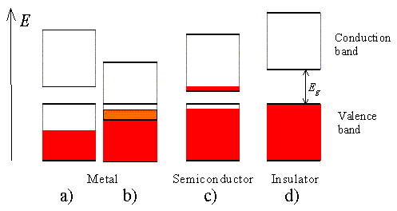
To further simplify the analysis, we assume that only the valence electrons (the electrons in the outer shell) are of interest.
The core electrons are tightly bound to the atom and are not allowed to freely move in the material.
Four different possible scenarios are possible.

Slide 8
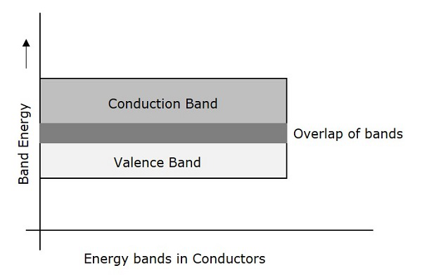
Materials consisting of atoms that contain two valence electrons can still be highly conducting if the resulting filled band overlaps with an empty band.
This scenario is shown in (b)

Slide 9
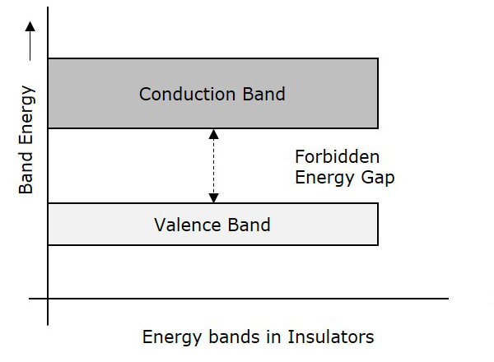
No conduction is expected for scenario d) where a completely filled band is separated from the next higher empty band by a larger energy gap.
Such materials behave as insulators.

Slide 10
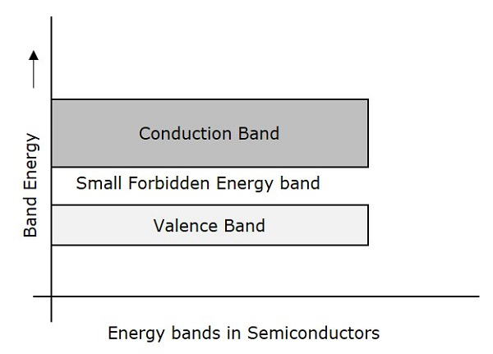
Finally, scenario c) depicts the situation in a semiconductor.
The completely filled band is now close enough to the next higher empty band that electrons can make it into the next higher band.

Slide 11
Intrinsic Semiconductors
Semiconductors that are chemically pure, in other words, free from impurities are termed as intrinsic semiconductors.
The number of holes and electrons is therefore determined by the properties of the material itself instead of the impurities.
In intrinsic semiconductors, the number of excited electrons is equal to the number of holes; n = p.
They are also termed as undoped semiconductors or i-type semiconductors.

Slide 12
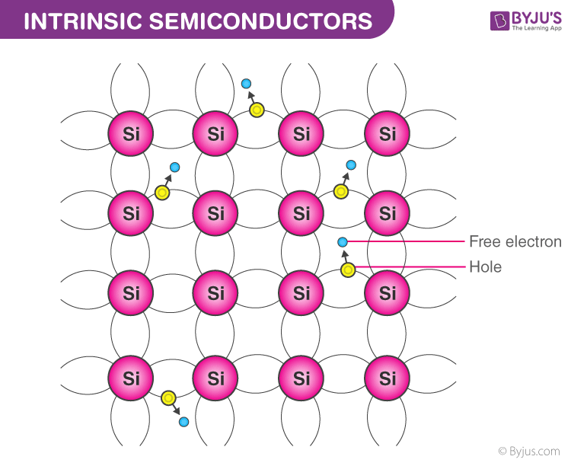
Silicon and germanium are examples of i-type semiconductors.
These elements belong to the IVth Group of the periodic table and their atomic numbers are 14 and 32 respectively.

Slide 13
Working Mechanism of Intrinsic Semiconductors
Electronic Configuration of Silicon and Germanium
Silicon 1s² 2s²2p⁶ 3s² 3p²
Germanium 1s² 2s² 2p⁶ 3s² 3p⁶ 4s² 3d¹⁰ 4p²

Slide 14
We notice from the electron configurations of both the elements that they have four electrons in their outermost shell or valence shell.
As the temperature of the semiconductor is increased, the electrons gain more thermal energy and thus break free from their shell.
The process of ionization of the atoms in the crystal lattice creates a vacancy in the bond between the atoms.

Slide 15
The position from which the electron gets dislodged has a hole which is equivalent to an effective positive charge.
The hole is then occupied by a free electron, as a result of which the latter vacant position becomes a hole and the former becomes a neutral position.
This way the hole or the effective positive charge is transferred from one position to another.

Slide 16
In an intrinsic semiconductor, the number of free electrons is equal to the number of holes.
Mathematically,
Here, the n_{i} gives the number of total intrinsic carrier concentration which is equal to the total number of holes or the total number of electrons.

Slide 17
When the temperature of an intrinsic semiconductor is T = 0K, it behaves like an insulator.
When the temperature is increased further, (T>0), the electrons get excited and move from the valence band to the conduction band.
These electrons occupy the conduction band partially, leaving a correspondingly equal number of holes in the valence band.

Slide 18
The conductivity of an intrinsic semiconductor depends on the surrounding temperature.
At room temperature, it exhibits a low conductivity.
Due to its low conductivity, it is deemed unsuitable for use in electronic devices.
In order to deal with this problem, the concept of doping arose, and as a result of which extrinsic semiconductors were manufactured.

Slide 19
Extrinsic Semiconductors
Extrinsic semiconductors are semiconductors that are doped with specific impurities.
The impurity modifies the electrical properties of the semiconductor and makes it more suitable for electronic devices such as diodes and transistors.
While adding impurities, a small amount of suitable impurity is added to pure material, increasing its conductivity by many times.

Slide 20
Extrinsic semiconductors are also called impurity semiconductors or doped semiconductors.
The process of adding impurities deliberately is termed as doping and the atoms that are used as an impurity are termed as dopants.
The impurity modifies the electrical properties of the semiconductor and makes it more suitable for electronic devices such as diodes and transistors.

Slide 21
The dopant added to the material is chosen such that the original lattice of the pure semiconductor is not distorted.
Also, the dopants occupy only a few of the sites in the crystal of the original semiconductor and it is necessary that the size of the dopant is nearly equal to the size of the semiconductor atoms.

Slide 22
Some Commonly Used Dopants
While doping tetravalent atoms such as Si or Ge, two types of dopants are used, and they are:
Pentavalent atoms: Atoms with valency 5; such as Arsenic (As), Phosphorous (Pi), Antimony (Sb), etc.
Trivalent atoms: Atoms with valency 3; such as Indium (In), Aluminium (Al), Boron (B), etc.

Slide 23
The reason behind using these dopants is to have similar-sized atoms as the pure semiconductor.
Both Silicon and Germanium atoms belong to the fourth group in the periodic table. Hence, the choice of dopants from the third and fifth group is more viable.
This ensures that the size of the atoms is not very different from the fourth group. Therefore, the trivalent and pentavalent choices.
These dopants give rise to two types of semiconductors:
N type
P type

Slide 24
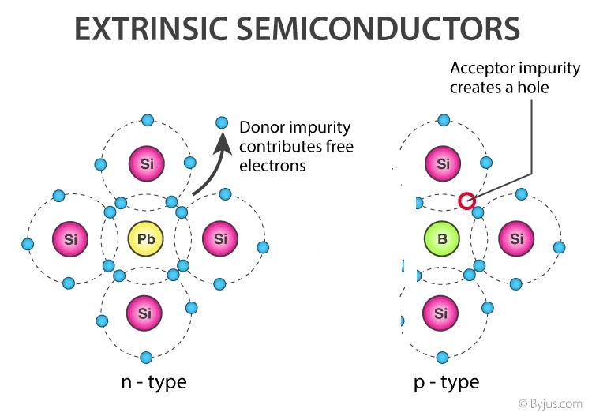
N-type semiconductors
When a tetravalent atom such as Si or Ge is doped with a pentavalent atom, it occupies the position of an atom in the crystal lattice of the Si atom.

Slide 25
The four of the electrons of the pentavalent atom bonds with the four neighboring silicon atoms and the fifth one remains weakly bound to the parent atom.
As a result of this, the ionization energy required to set the fifth electron free is very less and the electrons become free to move in the lattice of the semiconductor.
Such semiconductors are termed as n-type semiconductors.

Slide 26
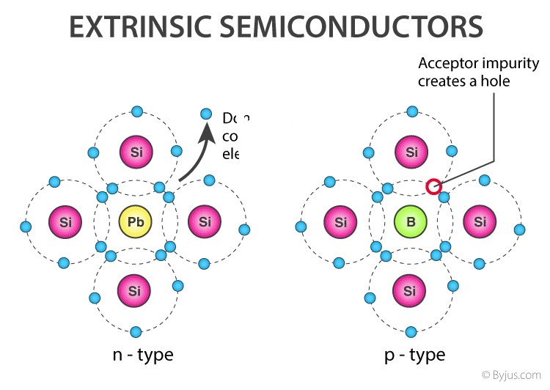
P-type semiconductors
When a tetravalent atom such as Si or Ge is doped with a trivalent impurity such as Al, B, In, etc., the dopant atom has one less electron than the surrounding atoms of Si or Ge.

Slide 27
Thus, the fourth atom of the tetravalent atom is free and a hole or a vacancy is generated in the trivalent atom.
In such materials, the holes are the charge carriers and such semiconductors are termed as p-type semiconductors.

Slide 28
Effect of doping on Minority Carriers
For majority carriers, the equilibrium carrier concentration is equal to the intrinsic carrier concentration plus the number of free carriers added by doping the semiconductor.
Under most conditions, the doping of the semiconductor is several orders of magnitude greater than the intrinsic carrier concentration, such that the number of majority carriers is approximately equal to the doping.

Slide 29
At equilibrium, the product of the majority and minority carrier concentration is a constant, and this is mathematically expressed by the Law of Mass Action.
$$n_{0}p_{0}={n_{i}}^{2}$$
where n_{i} is the intrinsic carrier concentration and n₀ and p₀ are the electron and hole equilibrium carrier concentrations.

Slide 30
Using the Law of Mass Action above, the majority and minority carrier concentrations are given as:
n-type: n₀=N_{D}, $p_{0}=\frac{{n_{i}}^{2}}{N_{D}}$
p-type: p₀=N_{A},
$$n_{0}=\frac{{n_{i}}^{2}}{N_{A}}$$
where N_{D} is the concentration of donor atoms and N_{A} is the concentration of acceptor atoms.

Slide 31
The above equations show that the number of minority carriers decreases as the doping level increases.
For example, in n-type material, some of the extra electrons added by doping the material will occupy the empty spots (i.e., holes) in the valence band, thus lowering the number of holes.

Slide 32
The above equations show that the number of minority carriers decreases as the doping level increases.
For example, in n-type material, some of the extra electrons added by doping the material will occupy the empty spots (i.e., holes) in the valence band, thus lowering the number of holes.

Slide 33

Theory of p-n junction
A p-n junction is an interface or a boundary between two semiconductor material types, namely the p-type and the n-type, inside a semiconductor.

Slide 34
Since the n-type region has a high electron concentration and the p-type a high hole concentration, electrons diffuse from the n-type side to the p-type side.
Similarly, holes flow by diffusion from the p-type side to the n-type side.
If the electrons and holes were not charged, this diffusion process would continue until the concentration of electrons and holes on the two sides were the same, as happens if two gasses come into contact with each other.

Slide 35
However, in a p-n junction, when the electrons and holes move to the other side of the junction, they leave behind exposed charges on dopant atom sites, which are fixed in the crystal lattice and are unable to move. On the n-type side, positive ion cores are exposed.
On the p-type side, negative ion cores are exposed.

Slide 36
An electric field E forms between the positive ion cores in the n-type material and negative ion cores in the p-type material.
This region is called the "depletion region" since the electric field quickly sweeps free carriers out, hence the region is depleted of free carriers.
A "built-in" potential V_{bi} is formed at the junction due to E.

Slide 37
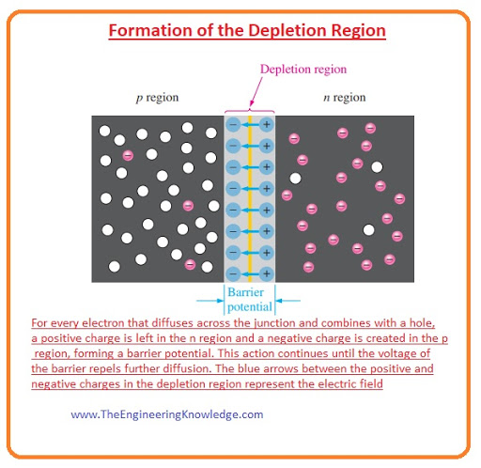
For every electrons that diffuses across the junction and combines with a hole, a positive charge is left in the n region and a negative charge is created in the p region, forming a barrier potential.
This action continues until the potential of the barrier repels further diffusion.
The blue arrows between the positive and negative charges in the depletion region represent the electric field.

Slide 38
P-N Junction Formula
The formula used in the p-n junction depends upon the built-in potential difference created by the electric field is given as:
$$V_{bi}=\frac{kT}{q}ln(\frac{N_{D }N_{A}}{{n_{i}}^{2}})$$
$$V_{bi}=V_{T}ln(\frac{N_{D }N_{A}}{{n_{i}}^{2}})$$
Where, E₀ is the zero bias junction voltage, V_{T} is the thermal voltage of 25mV at room temperature, N_{D} and N_{A} are the impurity concentrations and n_{i} is the intrinsic concentration.

Slide 39
Bias in p-n junction
There are two operating regions (n and p) and three possible “biasing” conditions for the standard Junction Diode and these are:
Zero Bias – No external voltage potential is applied to the PN junction diode.
Reverse Bias – The voltage potential is connected negative, (-ve) to the P-type material and positive, (+ve) to the N-type material across the diode which has the effect of Increasing the PN junction diode’s width.
Forward Bias – The voltage potential is connected positive, (+ve) to the P-type material and negative, (-ve) to the N-type material across the diode which has the effect of Decreasing the PN junction diodes width.

Slide 40
Zero Biased Junction Diode
When a diode is connected in a Zero Bias condition, no external potential energy is applied to the PN junction.
However if the diodes terminals are shorted together, a few holes (majority carriers) in the P-type material with enough energy to overcome the potential barrier will move across the junction against this barrier potential.
This is known as the “Forward Current” and is referenced as I_{F}.

Slide 41
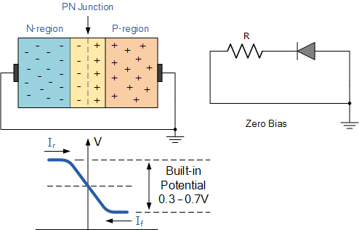
Likewise, holes generated in the N-type material (minority carriers), find this situation favourable and move across the junction in the opposite direction.
This is known as the “Reverse Current” and is referenced as I_{R}.
This transfer of electrons and holes back and forth across the PN junction is known as diffusion

Slide 42
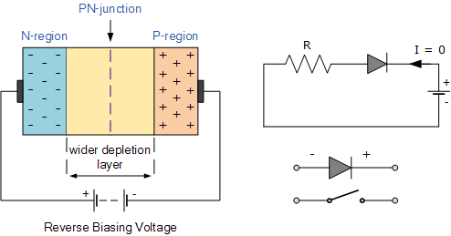
Reverse Biased PN Junction Diode
When a diode is connected in a Reverse Bias condition, a positive voltage is applied to the N-type material and a negative voltage is applied to the P-type material.

Slide 43
The positive voltage applied to the N-type material attracts electrons towards the positive electrode and away from the junction, while the holes in the P-type end are also attracted away from the junction towards the negative electrode.
The net result is that the depletion layer grows wider due to a lack of electrons and holes and presents a high impedance path, almost an insulator and a high potential barrier is created across the junction thus preventing current from flowing through the semiconductor material.

Slide 44
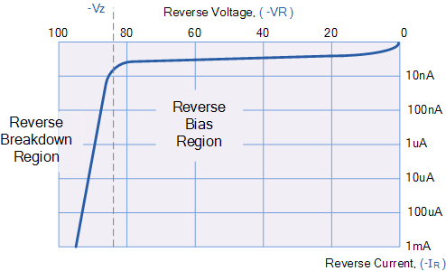
This condition represents a high resistance value to the PN junction and practically zero current flows through the junction diode with an increase in bias voltage.
However, a very small reverse leakage current does flow through the junction which can normally be measured in micro-amperes, (μA).

Slide 45
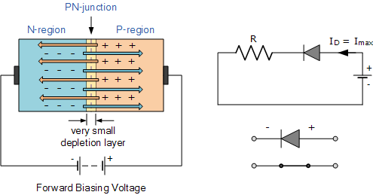
Forward Biased PN Junction Diode
When a diode is connected in a Forward Bias condition, a negative voltage is applied to the N-type material and a positive voltage is applied to the P-type material.
If this external voltage becomes greater than the value of the potential barrier, approx. 0.7 volts for silicon and 0.3 volts for germanium, the potential barriers opposition will be overcome and current will start to flow.

Slide 46
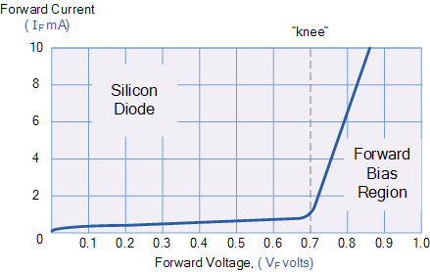
This is because the negative voltage pushes or repels electrons towards the junction giving them the energy to cross over and combine with the holes being pushed in the opposite direction towards the junction by the positive voltage.
This results in a characteristics curve of zero current flowing up to this voltage point, called the “knee” on the static curves and then a high current flow through the diode with little increase in the external voltage

Slide 47
Transistors
A transistor is a semiconductor device used to amplify or switch electrical signals and power.
The transistor is one of the basic building blocks of modern electronics.
It is composed of semiconductor material, usually with at least three terminals for connection to an electronic circuit.

Slide 48
Constructional Details of a Transistor
The Transistor is a three terminal solid state device which is formed by connecting two diodes back to back.
Hence it has got two PN junctions.
Three terminals are drawn out of the three semiconductor materials present in it.
This type of connection offers two types of transistors.

Slide 49
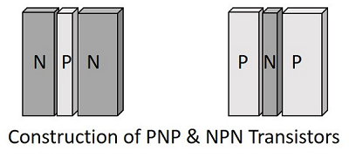
They are PNP and NPN which means an N-type material between two P types and the other is a P-type material between two N-types respectively.
The three terminals drawn from the transistor indicate Emitter, Base and Collector terminals.

Slide 50
Emitter
The left hand side of the above shown structure can be understood as Emitter.
This has a moderate size and is heavily doped as its main function is to supply a number of majority carriers, i.e. either electrons or holes.
As this emits electrons, it is called as an Emitter.
This is simply indicated with the letter E.

Slide 51
Base
The middle material in the above figure is the Base.
This is thin and lightly doped.
Its main function is to pass the majority carriers from the emitter to the collector.
This is indicated by the letter B.

Slide 52
Collector
The right side material in the above figure can be understood as a Collector.
Its name implies its function of collecting the carriers.
This is a bit larger in size than emitter and base. It is moderately doped.
This is indicated by the letter C.

Slide 53
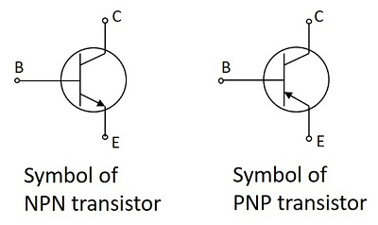
Symbols of PNP and NPN transistors
The arrow-head in the above figures indicated the emitter of a transistor.
As the collector of a transistor has to dissipate much greater power, it is made large.
Due to the specific functions of emitter and collector, they are not interchangeable. Hence the terminals are always to be kept in mind while using a transistor.

Slide 54
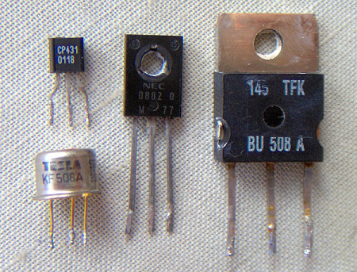
In a Practical transistor, there is a notch present near the emitter lead for identification.
The PNP and NPN transistors can be differentiated using a Multimeter.
The following figure shows how different practical transistors look like.

Slide 55
Superconductivity
If mercury is cooled below 4.1 K, it loses all electric resistance.
This discovery of superconductivity by H. Kammerlingh Onnes in 1911 was followed by the observation of other metals which exhibit zero resistivity below a certain critical temperature.
This temperature, called the transition temperature, varies for different materials but generally is below 20 K (−253 °C).

Slide 56
The fact that the resistance is zero has been demonstrated by sustaining currents in superconducting lead rings for many years with no measurable reduction.
An induced current in an ordinary metal ring would decay rapidly from the dissipation of ordinary resistance, but superconducting rings had exhibited a decay constant of over a billion years!
One of the properties of a superconductor is that it will exclude magnetic fields, a phenomenon called the Meissner effect.

Slide 57
Applications
Films of the new materials can carry currents in the superconducting state that are large enough to be of importance in making many devices.
Possible applications of the high-temperature superconductors in thin-film or bulk form include the construction of computer parts (logic devices, memory elements, switches, and interconnects), oscillators, amplifiers, particle accelerators, highly sensitive devices for measuring magnetic fields, voltages or currents, magnets for medical magnetic-imaging devices, magnetic energy-storage systems, levitated passenger trains for high-speed travel, motors, generators, transformers, and transmission lines.

Slide 58
Equipment made with the high-temperature superconductors would also be more economical to operate because such materials can be cooled with inexpensive liquid nitrogen (boiling point, 77 K) rather than with costly liquid helium (boiling point, 4.2 K).
The ceramics have problems, however, which must be overcome before useful devices can be made from them.

Slide 59
Ceramics
A ceramic is an inorganic non-metallic solid made up of either metal or non-metal compounds that have been shaped and then hardened by heating to high temperatures.
In general, they are hard, corrosion-resistant and brittle.

Slide 60
Traditional ceramics are clay-based, but high-performance or advanced ceramics are being developed from a far wider range of inorganic non-metal materials.
Advanced ceramics have the properties of high strength, high hardness, high durability and high toughness.

Slide 61
'Ceramic' comes from the Greek word meaning ‘pottery’.
The clay-based domestic wares, art objects and building products are familiar to us all, but pottery is just one part of the ceramic world.
Nowadays the term ‘ceramic’ has a more expansive meaning and includes materials like glass, advanced ceramics and some cement systems as well.

Slide 62
Traditional ceramics – pottery
Pottery is one of the oldest human technologies.
Fragments of clay pottery found recently in Hunan Province in China have been carbon dated to 17,500–18,300 years old.
The major types of pottery are described as earthenware, stoneware and porcelain.

Slide 63
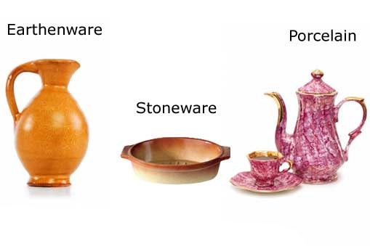
Earthenware
Earthenware is used extensively for pottery tableware and decorative objects.
It is one of the oldest materials used in pottery.
The clay is fired at relatively low temperatures (1,000–1,150°C), producing a slightly porous, coarse product.

Slide 64
Stoneware
Stoneware clay is fired at a high temperature (about 1,200°C) until made glass-like (vitrified).
Because stoneware is non-porous, glaze is applied only for decoration.
It is a sturdy, chip-resistant and durable material suitable for use in the kitchen for cooking, baking, storing liquids and as serving dishes.

Slide 65
Porcelain
Porcelain is a very hard, translucent white ceramic.
The earliest forms of porcelain originated in China around 1600BC, and by 600AD, Chinese porcelain was a prized commodity with Arabian traders.
Because porcelain was associated with China and often used to make plates, cups, vases and other works of fine art, it often goes by the name of ‘fine china'.

Slide 66
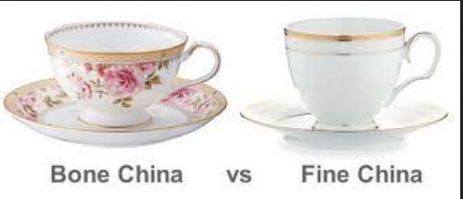
Bone china
Bone china – which is easier to make, harder to chip and stronger than porcelain – is made by adding ash from cattle bones to clay, feldspar minerals and fine silica sand.

Slide 67
Advanced ceramics – new materials
Advanced ceramics are not generally clay-based. Instead, they are either based on oxides or non-oxides or combinations of the two:
Typical oxides used are alumina (Al₂O₃) and zirconia (ZrO2).
Non-oxides are often carbides, borides, nitrides and silicides, for example, boron carbide (B₄C), silicon carbide (SiC) and molybdenum disilicide (MoSi₂).

Slide 68
Production processes firstly involve thoroughly blending the very fine constituent material powders.
After shaping them into a green body, this is high-temperature fired (1,600–1,800°C). This step is often carried out in an oxygen-free atmosphere.
The high temperature allows the tiny grains of the individual ceramic components to fuse together, forming a hard, tough, durable and corrosion-resistant product.
This process is called sintering.

Slide 69
Applications of advanced ceramics
Advanced ceramic materials are now well established in many areas of everyday use, from fridge magnets to an increasing range or industries, including metals production and processing, aerospace, electronics, automotive and personnel protection.
In modern medicine, advanced ceramics – often referred to as bioceramics – play an increasingly important role.
Bioceramics such as alumina and zirconia are hard, chemically inert materials that can be polished to a high finish. They are used as dental implants and as bone substitutes in orthopaedic operations such as hip and knee replacement.

Slide 70
Plastics
Plastics are a group of materials, either synthetic or naturally occurring, that may be shaped when soft and then hardened to retain the given shape.
Plastics are polymers.
A polymer is a substance made of many repeating units.
The word polymer comes from two Greek words: poly, meaning many, and meros, meaning parts or units.

Slide 71
A polymer can be thought of as a chain in which each link is the “mer,” or monomer (single unit).
The chain is made by joining, or polymerizing, at least 1,000 links together.
Polymerization can be demonstrated by making a chain using paper clips or by linking many strips of paper together to form a paper garland.

Slide 72

Plastics also can be divided into two distinct categories on the basis of their chemical composition.
One category is plastics that are made up of polymers having only aliphatic (linear) carbon atoms in their backbone chains.
All the commodity plastics fall into this category.

Slide 73

The other category of plastics is made up of heterochain polymers. These compounds contain atoms such as oxygen, nitrogen, or sulfur in their backbone chains, in addition to carbon.
Most of the engineering plastics listed above are composed of heterochain polymers.

Slide 74
Characteristics of Polymers
They are resistant to chemicals.
They are insulators of heat and electricity.
They are light in mass and have varying degrees of strength.
They can be processed in various ways to produce fibers, sheets, foams, or intricate molded parts.
The raw material for manufacturing plastic products is called a resin.
Some of the most common resins are polyethylene (PE), polyethylene terephthalate (PET), polypropylene (PP), polyvinyl chloride (PVC), and polystyrene (PS). These resins are often used in packaging.

Slide 75
Applications
Plastics aid durability, sustainability, and long-lasting design and construction in buildings, homes, and infrastructure such as bridges.
Accessories like computers, cell phones, television, microwave, etc. are durable, lightweight, and even affordable as they contain plastic.
Varieties in sports are made with plastic, stuff like, plastic helmets, mouth guards, goggles, protective wear, etc.

Slide 76
End of Module IV Thank You

